Slide 1
CHAPTER 6
GRAPHS
All the programs in this file are selected from
Ellis Horowitz, Sartaj Sahni, and Susan Anderson-Freed
“Fundamentals of Data Structures in C”,
Computer Science Press, 1992.
CHAPTER 6

Slide 2
Definition
A graph G consists of two sets
  a finite, nonempty set of vertices V(G)
  a finite, possible empty set of edges E(G)
  G(V,E) represents a graph
An undirected graph is one in which the pair of vertices in a edge is unordered, (v0, v1) = (v1,v0)
A directed graph is one in which each edge is a directed pair of vertices, <v0, v1> != <v1,v0>
tail
head
CHAPTER 6

Slide 3
Examples for Graph
0
0
0
1
2
1
2
1
3
3
4
5
6
G1
2
G2
complete graph
incomplete graph
G3
V(G1)={0,1,2,3} E(G1)={(0,1),(0,2),(0,3),(1,2),(1,3),(2,3)}
V(G2)={0,1,2,3,4,5,6} E(G2)={(0,1),(0,2),(1,3),(1,4),(2,5),(2,6)}
V(G3)={0,1,2} E(G3)={<0,1>,<1,0>,<1,2>}
complete undirected graph: n(n-1)/2 edges
complete directed graph: n(n-1) edges
CHAPTER 6

Slide 4
Complete Graph
A complete graph is a graph that has the
maximum number of edges
  for undirected graph with n vertices, the maximum number of edges is n(n-1)/2
  for directed graph with n vertices, the maximum
  number of edges is n(n-1)
  example: G1 is a complete graph
CHAPTER 6

Slide 5
Adjacent and Incident
If (v0, v1) is an edge in an undirected graph,
  v0 and v1 are adjacent
  The edge (v0, v1) is incident on vertices v0 and v1
If <v0, v1> is an edge in a directed graph
  v0 is adjacent to v1, and v1 is adjacent from v0
  The edge <v0, v1> is incident on v0 and v1
CHAPTER 6

Slide 6
Figure 6.3
*Figure 6.3:Example of a graph with feedback loops and a
multigraph (p.260)
0
0
2
1
3
1
2
self edge
multigraph:
multiple occurrences
of the same edge
(a)
(b)
CHAPTER 6

Slide 7
Subgraph and Path
A subgraph of G is a graph G’ such that V(G’)
is a subset of V(G) and E(G’) is a subset of E(G)
A path from vertex vp to vertex vq in a graph G,
is a sequence of vertices, vp, vi1, vi2, ..., vin, vq,
such that (vp, vi1), (vi1, vi2), ..., (vin, vq) are edges
in an undirected graph
The length of a path is the number of edges on it
CHAPTER 6

Slide 8
Figure 6.4: subgraphs of G₁ and G₃ (p.261)
0
0
0
1
2
0
1
2
1
2
3
1
2
3
3
G1
(i) (ii) (iii) (iv)
(a) Some of the subgraph of G₁
0
0
0
0
0
單一
1
1
1
1
分開
2
2
(i) (ii) (iii) (iv)
(b) Some of the subgraph of G₃
2
CHAPTER 6
G3

Slide 9
Simple Path and Cycle
A simple path is a path in which all vertices,
except possibly the first and the last, are distinct
A cycle is a simple path in which the first and
the last vertices are the same
In an undirected graph G, two vertices, v0 and v1, are connected if there is a path in G from v0 to v1
An undirected graph is connected if, for every
pair of distinct vertices vi, vj, there is a path
from vi to vj
CHAPTER 6

Slide 10
connected
0
0
1
2
1
2
3
3
4
5
6
G1
G2
tree (acyclic graph)
CHAPTER 6

Slide 11
Connected Component
A connected component of an undirected graph
is a maximal connected subgraph.
A tree is a graph that is connected and acyclic.
A directed graph is strongly connected if there
is a directed path from vi to vj and also
from vj to vi.
A strongly connected component is a maximal subgraph that is strongly connected.
CHAPTER 6

Slide 12
*Figure 6.5: A graph with two connected components (p.262)
connected component (maximal connected subgraph)
H₁
0
H₂
4
2
1
5
3
6
7
G₄ (not connected)
CHAPTER 6

Slide 13
*Figure 6.6: Strongly connected components of G₃ (p.262)
strongly connected component
(maximal strongly connected subgraph)
not strongly connected
0
0
2
1
1
2
G3
CHAPTER 6

Slide 14
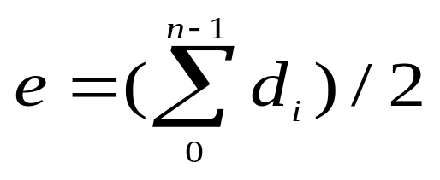
Degree
The degree of a vertex is the number of edges incident to that vertex
For directed graph,
  the in-degree of a vertex v is the number of edges
  that have v as the head
  the out-degree of a vertex v is the number of edges
  that have v as the tail
  if di is the degree of a vertex i in a graph G with n vertices and e edges, the number of edges is
CHAPTER 6

Slide 15
undirected graph
degree
3
0
0
2
1
2
3
1
2
3
3
3
3
4
5
6
3
3
1
G1
1
G2
1
1
0
in:1, out: 1
directed graph
in-degree
out-degree
1
in: 1, out: 2
2
in: 1, out: 0
CHAPTER 6
G3

Slide 16
ADT for Graph
structure Graph is
objects: a nonempty set of vertices and a set of undirected edges, where each
edge is a pair of vertices
functions: for all graph ∈ Graph, v, v₁ and v₂ ∈ Vertices
Graph Create()::=return an empty graph
Graph InsertVertex(graph, v)::= return a graph with v inserted. v has no
incident edge.
Graph InsertEdge(graph, v1,v2)::= return a graph with new edge
between v1 and v2
Graph DeleteVertex(graph, v)::= return a graph in which v and all edges
incident to it are removed
Graph DeleteEdge(graph, v1, v2)::=return a graph in which the edge (v1, v2)
is removed
Boolean IsEmpty(graph)::= if (graph==empty graph) return TRUE
else return FALSE
List Adjacent(graph,v)::= return a list of all vertices that are adjacent to v
CHAPTER 6

Slide 17
Graph Representations
Adjacency Matrix
Adjacency Lists
Adjacency Multilists
CHAPTER 6

Slide 18
Adjacency Matrix
Let G=(V,E) be a graph with n vertices.
The adjacency matrix of G is a two-dimensional
n by n array, say adj_mat
If the edge (vi, vj) is in E(G), adj_mat[i][j]=1
If there is no such edge in E(G), adj_mat[i][j]=0
The adjacency matrix for an undirected graph is symmetric; the adjacency matrix for a digraph
need not be symmetric
CHAPTER 6

Slide 19
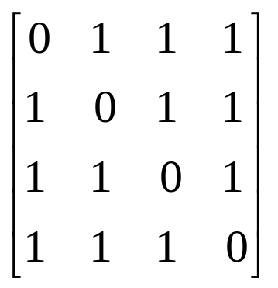
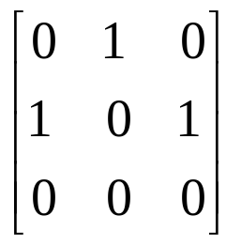
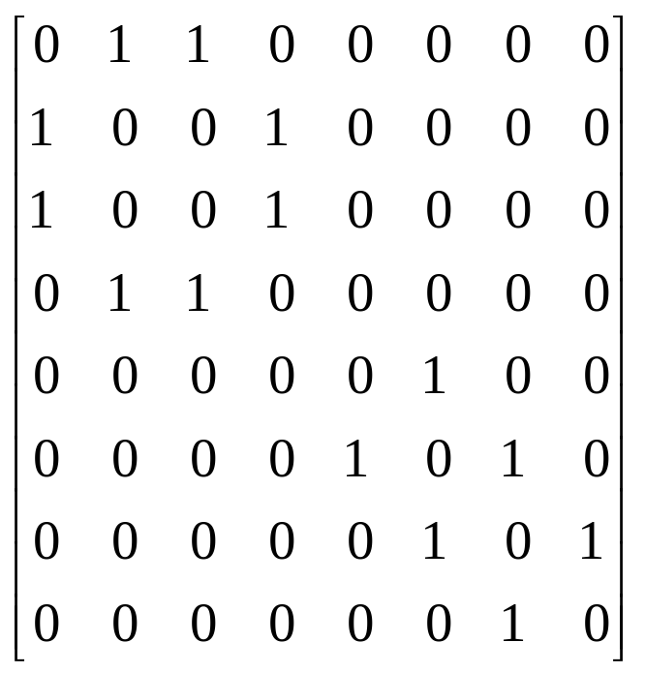
Examples for Adjacency Matrix
0
0
4
0
2
1
5
1
2
3
6
3
1
7
2
G2
G1
symmetric
undirected: n²/2
directed: n²
CHAPTER 6
G4

Slide 20
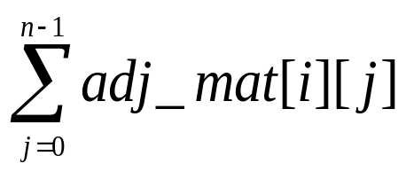
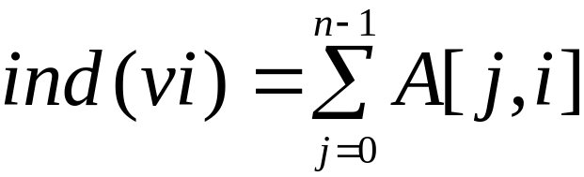
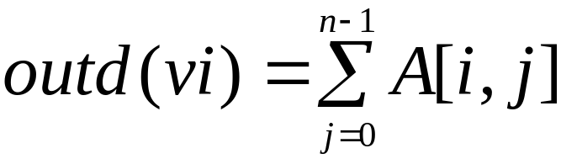
Merits of Adjacency Matrix
From the adjacency matrix, to determine the connection of vertices is easy
The degree of a vertex is
For a digraph, the row sum is the out_degree, while the column sum is the in_degree
CHAPTER 6

Slide 21
Data Structures for Adjacency Lists
Each row in adjacency matrix is represented as an adjacency list.
#define MAX_VERTICES 50
typedef struct node *node_pointer;
typedef struct node {
int vertex;
struct node *link;
};
node_pointer graph[MAX_VERTICES];
int n=0; /* vertices currently in use */
CHAPTER 6

Slide 22
0
0
4
2
1
5
1
2
3
6
3
7
0
1
2
3
1
2
3
0
1
2
3
4
5
6
7
1
2
0
2
3
0
3
0
1
3
0
3
0
1
2
1
2
G1
0
5
4
6
0
1
2
1
5
7
0
2
1
6
G3
G4
2
CHAPTER 6
An undirected graph with n vertices and e edges ==> n head nodes and 2e list nodes

Slide 23
Interesting Operations
degree of a vertex in an undirected graph
  # of nodes in adjacency list
# of edges in a graph
  determined in O(n+e)
out-degree of a vertex in a directed graph
  # of nodes in its adjacency list
in-degree of a vertex in a directed graph
  traverse the whole data structure
CHAPTER 6

Slide 24
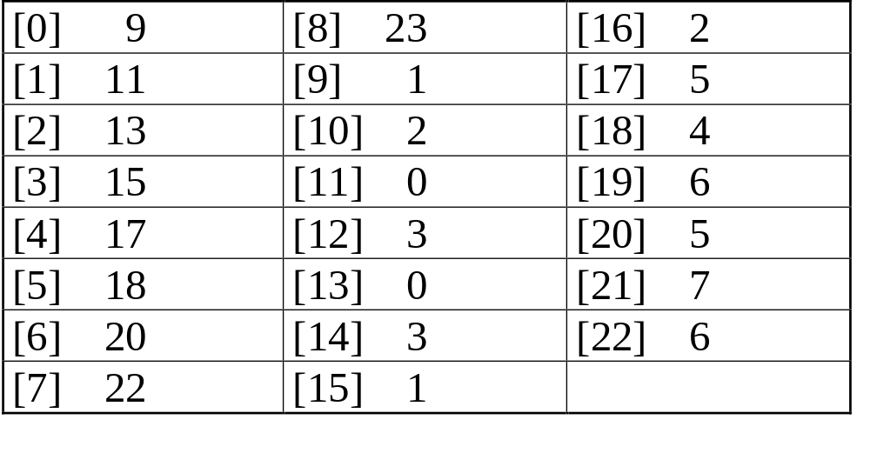
Compact Representation
0
4
node[0] … node[n-1]: starting point for vertices
node[n]: n+2e+1
node[n+1] … node[n+2e]: head node of edge
2
1
5
3
6
7
0
4
5
1
6
2
7
3
CHAPTER 6

Slide 25
Figure 6.10: Inverse adjacency list for G₃
0
0
1
2
•
•
•
1 NULL
1
0 NULL
1 NULL
2
Determine in-degree of a vertex in a fast way.
CHAPTER 6

Slide 26
Figure 6.11: Alternate node structure for adjacency lists (p.267)
tail head column link for head row link for tail
CHAPTER 6

Slide 27
Figure 6.12: Orthogonal representation for graph G₃(p.268)
0
1
2
0
0 1 NULL NULL
1
1 0 NULL
1 2 NULL NULL
0
2 NULL
1
CHAPTER 6
2

Slide 28
Figure 6.13:Alternate order adjacency list for G₁ (p.268)
Order is of no significance.
headnodes vertax link
0
•
3 •
1 •
2 NULL
1
•
2 •
0 •
3 NULL
2
•
3 •
0 •
1 NULL
3
•
2 •
1 •
0 NULL
0
1
2
CHAPTER 6
3

Slide 29
Adjacency Multilists
An edge in an undirected graph is represented by two nodes in adjacency list representation.
Adjacency Multilists
  lists in which nodes may be shared among several lists.
  (an edge is shared by two different paths)
marked vertex1 vertex2 path1 path2
CHAPTER 6

Slide 30
Example for Adjacency Multlists
Lists: vertex 0: M1->M2->M3, vertex 1: M1->M4->M5
vertex 2: M2->M4->M6, vertex 3: M3->M5->M6
(1,0)
0
1
2
3
N1
N2
N3
N4
N5
N6
0 1 N2 N4
edge (0,1)
edge (0,2)
edge (0,3)
edge (1,2)
edge (1,3)
edge (2,3)
(2,0)
0 2 N3 N4
(3,0)
0 3 N5
(2,1)
1 2 N5 N6
0
(3,1)
1 3 N6
1
2
(3,2)
2 3
3
six edges
CHAPTER 6

Slide 31
Adjacency Multilists
typedef struct edge *edge_pointer;
typedef struct edge {
short int marked;
int vertex1, vertex2;
edge_pointer path1, path2;
};
edge_pointer graph[MAX_VERTICES];
marked vertex1 vertex2 path1 path2
CHAPTER 6

Slide 32
Some Graph Operations
Traversal
Given G=(V,E) and vertex v, find all w∈V,
such that w connects v.
  Depth First Search (DFS)
  preorder tree traversal
  Breadth First Search (BFS)
  level order tree traversal
Connected Components
Spanning Trees
CHAPTER 6

Slide 33
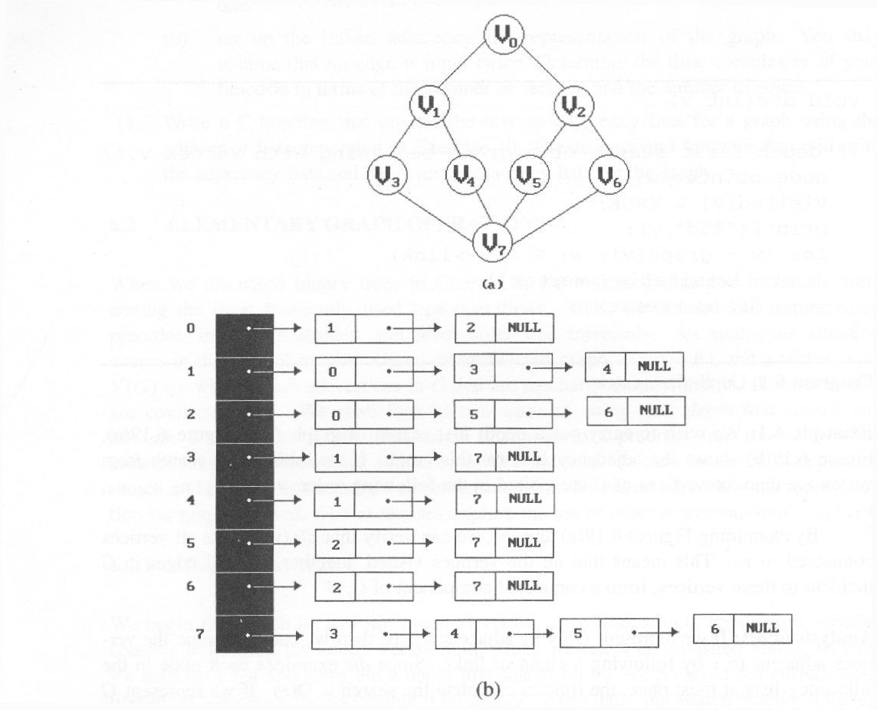
*Figure 6.19:Graph G and its adjacency lists (p.274)
depth first search: v0, v1, v3, v7, v4, v5, v2, v6
breadth first search: v0, v1, v2, v3, v4, v5, v6, v7
CHAPTER 6

Slide 34
Depth First Search
#define FALSE 0
#define TRUE 1
short int visited[MAX_VERTICES];
void dfs(int v)
{
node_pointer w;
visited[v]= TRUE;
printf(“%5d”, v);
for (w=graph[v]; w; w=w->link)
if (!visited[w->vertex])
dfs(w->vertex);
}
Data structure
adjacency list: O(e)
adjacency matrix: O(n²)
CHAPTER 6

Slide 35
Breadth First Search
typedef struct queue *queue_pointer;
typedef struct queue {
int vertex;
queue_pointer link;
};
void addq(queue_pointer *,
queue_pointer *, int);
int deleteq(queue_pointer *);
CHAPTER 6

Slide 36
Breadth First Search (Continued)
void bfs(int v)
{
node_pointer w;
queue_pointer front, rear;
front = rear = NULL;
printf(“%5d”, v);
visited[v] = TRUE;
addq(&front, &rear, v);
adjacency list: O(e)
adjacency matrix: O(n²)
CHAPTER 6

Slide 37
while (front) {
v= deleteq(&front);
for (w=graph[v]; w; w=w->link)
if (!visited[w->vertex]) {
printf(“%5d”, w->vertex);
addq(&front, &rear, w->vertex);
visited[w->vertex] = TRUE;
}
}
}
CHAPTER 6

Slide 38
Connected Components
void connected(void)
{
for (i=0; i<n; i++) {
if (!visited[i]) {
dfs(i);
printf(“\n”);
}
}
}
adjacency list: O(n+e)
adjacency matrix: O(n²)
CHAPTER 6

Slide 39
Spanning Trees
When graph G is connected, a depth first or
breadth first search starting at any vertex will
visit all vertices in G
A spanning tree is any tree that consists solely
of edges in G and that includes all the vertices
E(G): T (tree edges) + N (nontree edges)
where T: set of edges used during search
N: set of remaining edges
CHAPTER 6

Slide 40
Examples of Spanning Tree
0
0
0
0
1
2
1
2
1
2
1
2
3
3
3
3
G1
Possible spanning trees
CHAPTER 6

Slide 41
Spanning Trees
Either dfs or bfs can be used to create a
spanning tree
  When dfs is used, the resulting spanning tree is
  known as a depth first spanning tree
  When bfs is used, the resulting spanning tree is
  known as a breadth first spanning tree
While adding a nontree edge into any spanning
tree, this will create a cycle
CHAPTER 6

Slide 42
DFS VS BFS Spanning Tree
0
0
0
1
2
1
2
1
2
3
4
5
6
3
4
5
6
3
4
5
6
7
7
nontree edge
cycle
7
DFS Spanning
BFS Spanning
CHAPTER 6

Slide 43
A spanning tree is a minimal subgraph, G’, of G
such that V(G’)=V(G) and G’ is connected.
Any connected graph with n vertices must have
at least n-1 edges.
A biconnected graph is a connected graph that has
no articulation points.
0
1
2
biconnected graph
3
4
5
6
7
CHAPTER 6

Slide 44
0
8 9
2
7
1
3
5
connected graph
4
6
two connected components
one connected graph
8 9
0
8 9
0
2
7
2
7
1
1
3
5
3
5
CHAPTER 6
4
6
4
6

Slide 45
biconnected component: a maximal connected subgraph H
(no subgraph that is both biconnected and properly contains H)
0
8
9
0
8 9
1
7
7
2
7
1
2
7
1
3
5
3
3
5
5
4
6
4
6
biconnected components
CHAPTER 6

Slide 46
Find biconnected component of a connected undirected graph
by depth first spanning tree
nontree
edge
(back edge)
0
3
4 0
9 8 9 8
1 5
nontree
edge
(back edge)
4
5
7 7
3
1
0 5
3 5
2
4
2
6
7
6
2 2
3
1
7
dfn
depth
first
number
8 9
4 6
1 6
0
9
8
Why is cross edge impossible?
(a) depth first spanning tree (b)
If u is an ancestor of v then dfn(u) < dfn(v).
CHAPTER 6

Slide 47
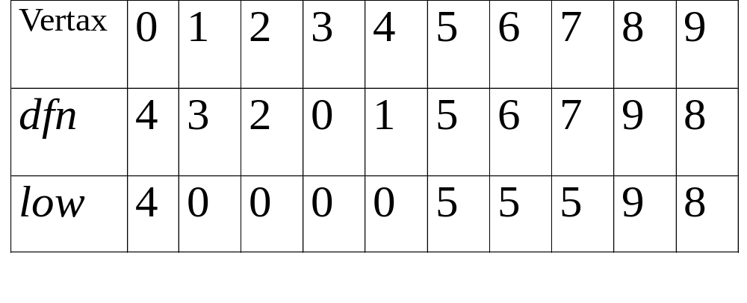
*Figure 6.24: dfn and low values for dfs spanning tree with root =3(p.281)
CHAPTER 6

Slide 48
0
3
*The root of a depth first spanning
tree is an articulation point iff
it has at least two children.
1 5
4
5
2
4
2
6
7
6
*Any other vertex u is an articulation
point iff it has at least one child w
such that we cannot reach an ancestor
of u using a path that consists of
(1) only w (2) descendants of w (3)
single back edge.
3
1
7
8 9
0
9
8
low(u)=min{dfn(u),
min{low(w)|w is a child of u},
min{dfn(w)|(u,w) is a back edge}
u: articulation point
low(child) ≥ dfn(u)
CHAPTER 6

Slide 49
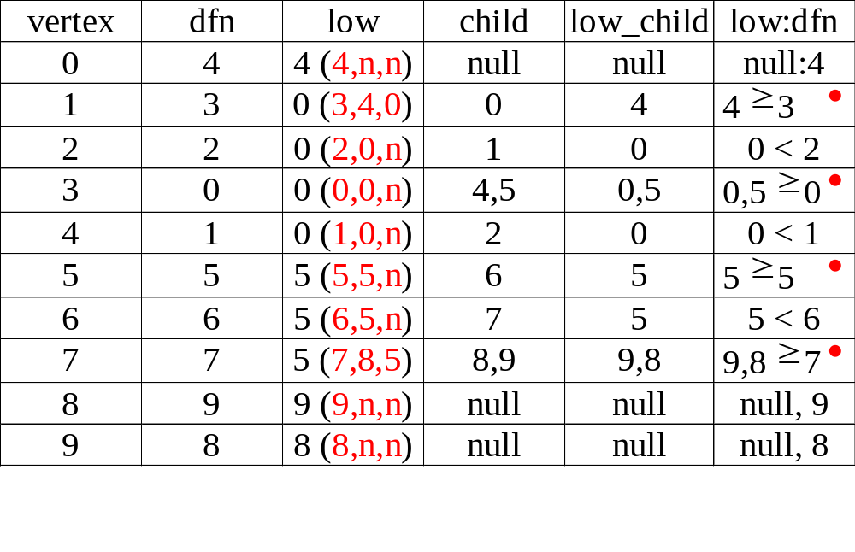
3
1 5
4
5
2
4
2
6
7
6
3
1
7
8 9
CHAPTER 6
0
9
8

Slide 50
*Program 6.5: Initializaiton of dfn and low (p.282)
void init(void)
{
int i;
for (i = 0; i < n; i++) {
visited[i] = FALSE;
dfn[i] = low[i] = -1;
}
num = 0;
}
CHAPTER 6

Slide 51
*Program 6.4: Determining dfn and low (p.282)
void dfnlow(int u, int v)
{
/* compute dfn and low while performing a dfs search
beginning at vertex u, v is the parent of u (if any) */
node_pointer ptr;
int w;
dfn[u] = low[u] = num++;
for (ptr = graph[u]; ptr; ptr = ptr ->link) {
w = ptr ->vertex;
if (dfn[w] < 0) { /*w is an unvisited vertex */
dfnlow(w, u);
low[u] = MIN2(low[u], low[w]);
}
else if (w != v)
low[u] =MIN2(low[u], dfn[w] );
}
}
Initial call: dfn(x,-1)
low[u]=min{dfn(u), …}
v
u
w
v
u
low[u]=min{…, min{low(w)|w is a child of u}, …}
dfn[w]≠0 非第一次，表示藉back edge
X
O
CHAPTER 6
low[u]=min{…,…,min{dfn(w)|(u,w) is a back edge}

Slide 52
*Program 6.6: Biconnected components of a graph (p.283)
void bicon(int u, int v)
{
/* compute dfn and low, and output the edges of G by their
biconnected components , v is the parent ( if any) of the u
(if any) in the resulting spanning tree. It is assumed that all
entries of dfn[ ] have been initialized to -1, num has been
initialized to 0, and the stack has been set to empty */
node_pointer ptr;
int w, x, y;
dfn[u] = low[u] = num ++;
for (ptr = graph[u]; ptr; ptr = ptr->link) {
w = ptr ->vertex;
if ( v != w && dfn[w] < dfn[u] )
add(&top, u, w); /* add edge to stack */
low[u]=min{dfn(u), …}
(1) dfn[w]=-1 第一次
(2) dfn[w]!=-1非第一次，藉back
edge
CHAPTER 6

Slide 53
if(dfn[w] < 0) {/* w has not been visited */ bicon(w, u); low[u] = MIN2(low[u], low[w]); if (low[w] >= dfn[u] ){ articulation point printf(“New biconnected component: “); do { /* delete edge from stack */ delete(&top, &x, &y); printf(“ <%d, %d>” , x, y);
} while (!(( x = = u) && (y = = w))); printf(“\n”);
}
} else if (w != v) low[u] = MIN2(low[u], dfn[w]);
}
}
low[u]=min{…, min{low(w)|w is a child of u}, …}
low[u]=min{…, …, min{dfn(w)|(u,w) is a back edge}}
CHAPTER 6

Slide 54
Minimum Cost Spanning Tree
The cost of a spanning tree of a weighted undirected graph is the sum of the costs of the edges in the spanning tree
A minimum cost spanning tree is a spanning
tree of least cost
Three different algorithms can be used
  Kruskal
  Prim
  Sollin
Select n-1 edges from a weighted graph
of n vertices with minimum cost.
CHAPTER 6

Slide 55
Greedy Strategy
An optimal solution is constructed in stages
At each stage, the best decision is made at this
time
Since this decision cannot be changed later,
we make sure that the decision will result in a feasible solution
Typically, the selection of an item at each
stage is based on a least cost or a highest profit criterion
CHAPTER 6

Slide 56
Kruskal’s Idea
Build a minimum cost spanning tree T by
adding edges to T one at a time
Select the edges for inclusion in T in
nondecreasing order of the cost
An edge is added to T if it does not form a
cycle
Since G is connected and has n > 0 vertices,
exactly n-1 edges will be selected
CHAPTER 6

Slide 57
Examples for Kruskal’s Algorithm
10
0 5
2 3
1 6
1 2
3 6
3 4
4 6
4 5
0 1
12
14
0
0
0
28
16
1
1
10
1
10
14
16
18
6
2
5
6
2
5
6
2
5
24
22
25
18
12
4
4
4
22
3
3
3
24
25
6/9
CHAPTER 6
28

Slide 58
0 5
2 3
1 6
1 2
3 6
3 4
4 6
4 5
0 1
10
12
14
16
0
0
0
10
1
10
1
10
1
18
14
14
16
22
5
6
2
5
6
2
5
6
2
12
12
12
24
4
4
4
3
3
3
25
28
+
3 6
CHAPTER 6
cycle

Slide 59
0 5
2 3
1 6
1 2
3 6
3 4
4 6
4 5
0 1
10
12
14
0
0
16
10
1
10
1
18
14
16
14
16
5
6
2
5
6
2
22
25
12
12
4
4
24
22
+
4 6
22
3
3
25
cycle
cost = 10 +25+22+12+16+14
28
CHAPTER 6

Slide 60
Kruskal’s Algorithm
目標：取出n-1條edges
T= {};
while (T contains less than n-1 edges
&& E is not empty) {
choose a least cost edge (v,w) from E;
delete (v,w) from E;
if ((v,w) does not create a cycle in T)
add (v,w) to T
else discard (v,w);
}
if (T contains fewer than n-1 edges)
printf(“No spanning tree\n”);
min heap construction time O(e)
choose and delete O(log e)
find find & union O(log e)
{0,5}, {1,2,3,6}, {4} + edge(3,6) X + edge(3,4) --> {0,5},{1,2,3,4,6}
CHAPTER 6
O(e log e)

Slide 61


Prim’s Algorithm
(tree all the time vs. forest)
T={};
TV={0};
while (T contains fewer than n-1 edges)
{
let (u,v) be a least cost edge such
that and
if (there is no such edge ) break;
add v to TV;
add (u,v) to T;
}
if (T contains fewer than n-1 edges)
printf(“No spanning tree\n”);
CHAPTER 6

Slide 62
Examples for Prim’s Algorithm
0
28
10
1
14
16
5
6
2
24
25
0
18
12
0
0
4
10
1
22
3
1
10
1
10
5
6
2
5
6
2
5
6
2
25
25
4
4
4
3
3
22
3
CHAPTER 6

Slide 63
0
28
10
1
14
16
5
6
2
24
25
18
12
4
22
3
0
0
0
10
1
10
1
10
1
16
14
16
5
6
2
5
6
2
5
6
2
25
25
25
4
12
4
12
4
12
22
3
22
3
22
3
CHAPTER 6

Slide 64
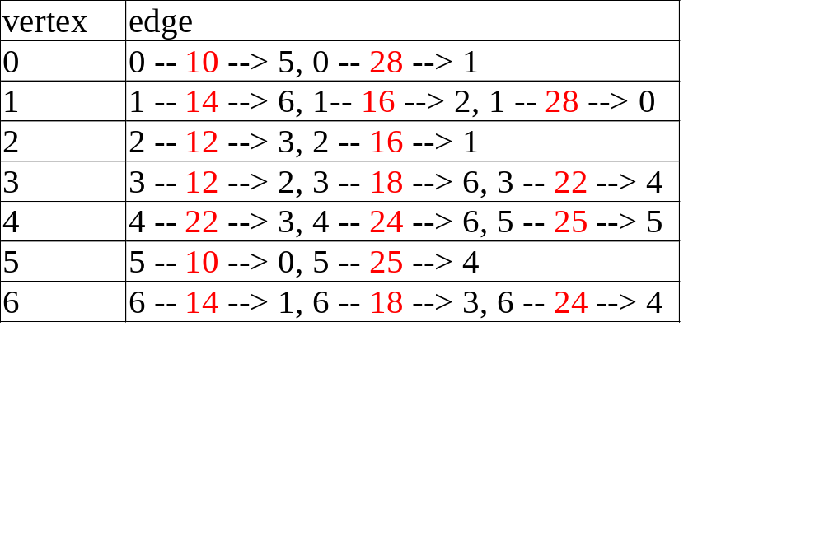
Sollin’s Algorithm
0
28
10
1
14
16
5
6
2
24
25
18
12
4
22
3
0
0
{0,5}
0
25
28
1
1
10
1
5 4
0 1
10
14
14
16
{1,6}
5
6
2
5
6
2
5
6
2
16
28
1 2
1
0
12
4
12
4
4
24
CHAPTER 6
18
6 4
22
6 3
22
3
3
3

Slide 65
*Figure 6.29: Graph and shortest paths from v₀ (p.293)
Single Source All Destinations
Determine the shortest paths from v0 to all the remaining vertices.
45
50 10
path length
1) v0 v2 10
2) v0 v2 v3 25
3) v0 v2 v3 v1 45
4) v0 v4 45
(b)
V₀
V₁
V₄
20 10 15 20 35 30
V₂
15 3
V₃
V₅
(a)
CHAPTER 6

Slide 66
Example for the Shortest Path
Boston
4
1500
San
Francisco
Chicago
Denver
1200
3
250
800
2
1000
1
5
New
York
300
1000
1400
1700
New Orleans
900
0
7
1000
Los Angeles
6
Miami
0 1 2 3 4 5 6 7
0 0
1 300 0
2 1000 800 0
3 1200 0
4 1500 0 250
5 1000 0 900 1400
6 0 1000
7 1700 0
CHAPTER 6
Cost adjacency matrix

Slide 67
(a)
(b)
(c)
4
1500
4
1500
4
250
3
3
5
250
250
5
1000
5
900
6
選5
4到3由1500改成1250
4到6由∞改成1250
4
4
(d)
(f)
4
(e)
3
250
250
1000
250
5
5
7
1400
5
7
1400
7
1400
900
6
1000
900
6
4到7由∞改成1650
選6
4-5-6-7比4-5-7長
CHAPTER 6

Slide 68
(g)
(h)
4
4
3
1200
3
250
2
1000
250
5
1000
7
5
1400
7
1400
900
900
6
6
選3
4到2由∞改成2450
(i)
4
4
2
1200
3
(j)
250
250
1000
0
5
5
7
1400
7
1400
900
6
4到0由∞改成3350
CHAPTER 6
選7

Slide 69
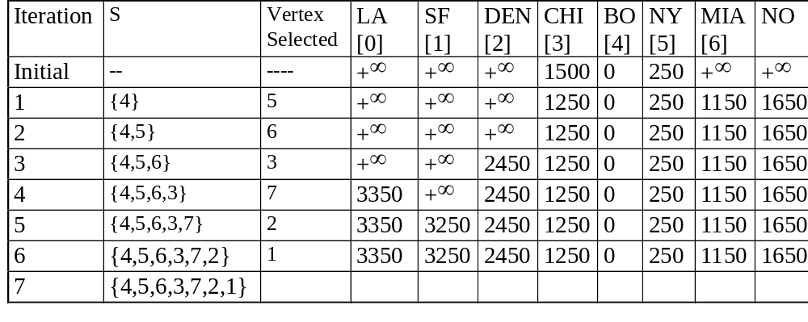
Example for the Shortest Path
(Continued)
(b)
(c)
(d)
(a)
(f)
(e)
(h)
(g)
(j)
(i)
CHAPTER 6

Slide 70
Data Structure for SSAD
#define MAX_VERTICES 6
int cost[][MAX_VERTICES]=
{{ 0, 50, 10, 1000, 45, 1000},
{1000, 0, 15, 1000, 10, 1000},
{ 20, 1000, 0, 15, 1000, 1000},
{1000, 20, 1000, 0, 35, 1000},
{1000, 1000, 30, 1000, 0, 1000},
{1000, 1000, 1000, 3, 1000, 0}};
int distance[MAX_VERTICES];
short int found{MAX_VERTICES];
int n = MAX_VERTICES;
adjacency matrix
CHAPTER 6

Slide 71
Single Source All Destinations
void shortestpath(int v, int cost[][MAX_ERXTICES], int distance[], int n, short int found[])
{
int i, u, w;
for (i=0; i<n; i++) {
found[i] = FALSE;
distance[i] = cost[v][i];
}
found[v] = TRUE;
distance[v] = 0;
O(n)
CHAPTER 6

Slide 72
for (i=0; i<n-2; i++) {determine n-1 paths from v
u = choose(distance, n, found);
found[u] = TRUE;
for (w=0; w<n; w++)
if (!found[w])
if (distance[u]+cost[u][w]<distance[w])
distance[w] = distance[u]+cost[u][w];
}
}
與u相連的端點w
O(n²)
CHAPTER 6

Slide 73
All Pairs Shortest Paths
Find the shortest paths between all pairs of vertices.
Solution 1
  Apply shortest path n times with each vertex as source.
  O(n³)
Solution 2
  Represent the graph G by its cost adjacency matrix with cost[i][j]
  If the edge <i,j> is not in G, the cost[i][j] is set to some sufficiently large number
  A[i][j] is the cost of the shortest path form i to j, using only those intermediate vertices with an index <= k
CHAPTER 6

Slide 74
All Pairs Shortest Paths (Continued)
n-1
The cost of the shortest path from i to j is A [i][j], as no vertex in G has an index greater than n-1
A [i][j]=cost[i][j]
Calculate the A, A, A, ..., A from A iteratively
A [i][j]=min{A [i][j], A [i][k]+A [k][j]}, k>=0
-1
0
1
2
n-1
-1
k
k-1
k-1
k-1
CHAPTER 6

Slide 75
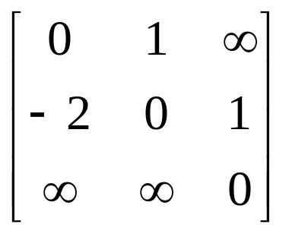
Graph with negative cycle
-2
0
1
2
1
1
(a) Directed graph (b) A⁻¹
The length of the shortest path from vertex 0 to vertex 2 is -∝.
0, 1, 0, 1,0, 1, …, 0, 1, 2
CHAPTER 6

Slide 76
Algorithm for All Pairs Shortest Paths
void allcosts(int cost[][MAX_VERTICES],
int distance[][MAX_VERTICES], int n)
{
int i, j, k;
for (i=0; i<n; i++)
for (j=0; j<n; j++)
distance[i][j] = cost[i][j];
for (k=0; k<n; k++)
for (i=0; i<n; i++)
for (j=0; j<n; j++)
if (distance[i][k]+distance[k][j]
< distance[i][j])
distance[i][j]=
distance[i][k]+distance[k][j];
}
CHAPTER 6

Slide 77
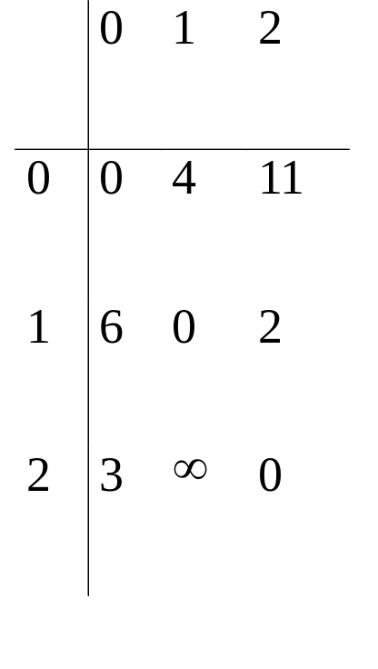
* Figure 6.33: Directed graph and its cost matrix (p.299)
6
4
V₀
V1
3 11 2
V₂
(a)Digraph G (b)Cost adjacency matrix for G
CHAPTER 6

Slide 78
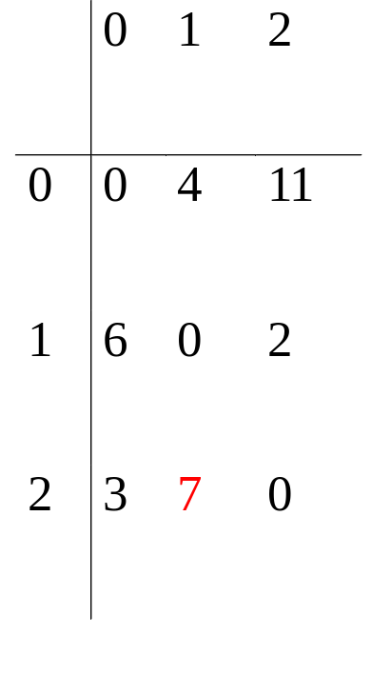
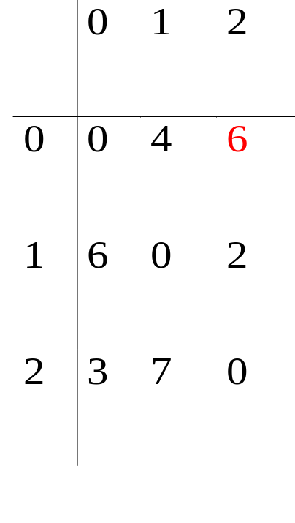
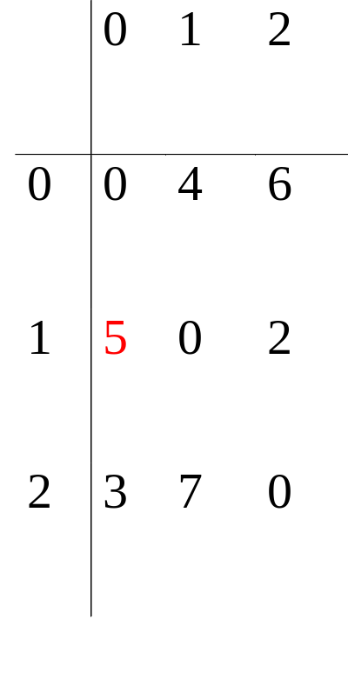
A⁻¹
6
4
A⁰
V₀
V1
A⁻¹
3 11 2
0 0
6 4
3 11
V₂
v0
A¹
A²
A⁰
A¹
4 6
0 0
7 2
6 3
2 7
0 0
v1
v2
CHAPTER 6

Slide 79
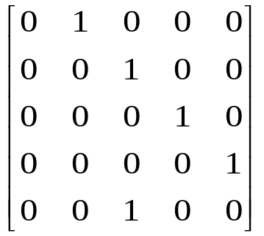
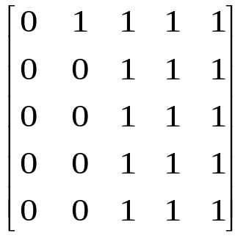
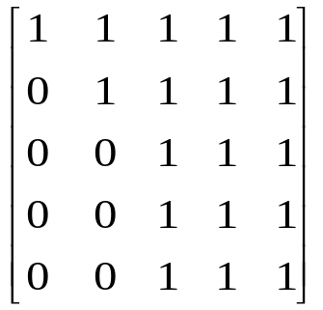
Transitive Closure
Goal: given a graph with unweighted edges, determine if there is a path
from i to j for all i and j.
(1) Require positive path (> 0) lengths.
(2) Require nonnegative path (≥0) lengths.
transitive closure matrix
reflexive transitive closure matrix
0
1
2
3
4
0
1
2
3
4
(a) Digraph G (b) Adjacency matrix A for G
0
1
2
3
4
0
1
2
3
4
cycle
reflexive
(c) transitive closure matrix A⁺ (d) reflexive transitive closure matrix A*
CHAPTER 6
There is a path of length > 0
There is a path of length ≥0

Slide 80
Activity on Vertex (AOV) Network
definition
A directed graph in which the vertices represent tasks or activities and the edges represent precedence relations between tasks.
predecessor (successor)
vertex i is a predecessor of vertex j iff there is a directed path from i to j. j is a successor of i.
partial order
a precedence relation which is both transitive (∀i, j, k, i•j & j•k => i•k ) and irreflexive (∀x ¬x•x).
acylic graph
a directed graph with no directed cycles
CHAPTER 6

Slide 81
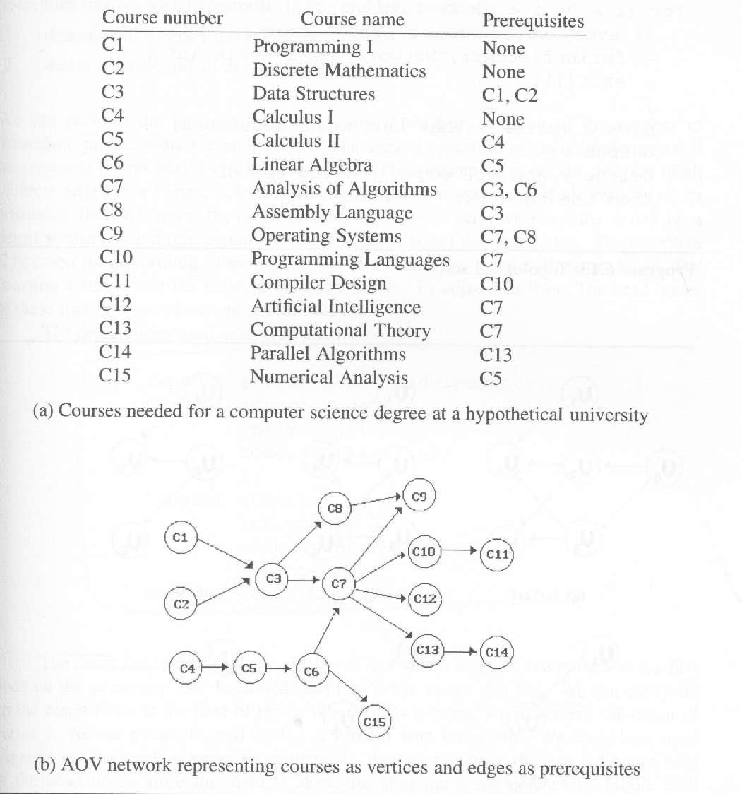
*Figure 6.38: An AOV network (p.305)
Topological order:
linear ordering of vertices
of a graph
∀i, j if i is a predecessor of
j, then i precedes j in the
linear ordering
C1, C2, C4, C5, C3, C6, C8,
C7, C10, C13, C12, C14, C15,
C11, C9
C4, C5, C2, C1, C6, C3, C8,
C15, C7, C9, C10, C11, C13,
C12, C14
CHAPTER 6

Slide 82
*Program 6.13: Topological sort (p.306)
for (i = 0; i <n; i++) {
if every vertex has a predecessor {
fprintf(stderr, “Network has a cycle. \n “ );
exit(1);
}
pick a vertex v that has no predecessors;
output v;
delete v and all edges leading out of v
from the network;
}
CHAPTER 6

Slide 83
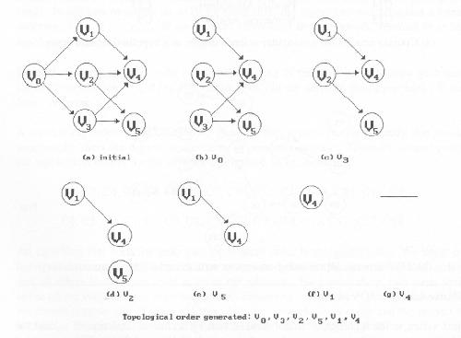
*Figure 6.39:Simulation of Program 6.13 on an AOV network (p.306)
v0 no predecessor
delete v0->v1, v0->v2, v0->v3
v1, v2, v3 no predecessor
select v3
delete v3->v4, v3->v5
select v2
delete v2->v4, v2->v5
select v5
select v1
delete v1->v4
CHAPTER 6

Slide 84
Issues in Data Structure Consideration
Decide whether a vertex has any predecessors.
  Each vertex has a count.
Decide a vertex together with all its incident edges.
  Adjacency list
CHAPTER 6

Slide 85
*Figure 6.40:Adjacency list representation of Figure 6.30(a)
(p.309)
headnodes
node
count
link
vertex
link
V₀
V₁
V₂
0 •
1 •
2 •
3 NULL
1 •
4 NULL
1 •
4 •
5 NULL
V₃
V₄
V₅
1 •
5 •
4 NULL
3 NULL
v1
2 NULL
v0
v2
v4
CHAPTER 6
v3
v5

Slide 86
*(p.307)
typedef struct node *node_pointer;
typedef struct node {
int vertex;
node_pointer link;
};
typedef struct {
int count;
node_pointer link;
} hdnodes;
hdnodes graph[MAX_VERTICES];
CHAPTER 6

Slide 87
*Program 6.14: Topological sort (p.308)
void topsort (hdnodes graph [] , int n)
{
int i, j, k, top;
node_pointer ptr;
/* create a stack of vertices with no predecessors */
top = -1;
for (i = 0; i < n; i++)
if (!graph[i].count) {no predecessors, stack is linked through
graph[i].count = top; count field
top = i;
}
for (i = 0; i < n; i++)
if (top == -1) {
fprintf(stderr, “\n Network has a cycle. Sort terminated. \n”);
exit(1);
}
O(n)
CHAPTER 6

Slide 88
Continued
}
else {
j = top; /* unstack a vertex */
top = graph[top].count;
printf(“v%d, “, j);
for (ptr = graph [j]. link; ptr ;ptr = ptr ->link ){
/* decrease the count of the successor vertices of j */
k = ptr ->vertex;
graph[k].count --;
if (!graph[k].count) {
/* add vertex k to the stack*/
graph[k].count = top;
top = k;
}
}
}
}
O(e)
O(e+n)
CHAPTER 6

Slide 89
Activity on Edge (AOE) Networks
directed edge
  tasks or activities to be performed
vertex
  events which signal the completion of certain activities
number
  time required to perform the activity
CHAPTER 6

Slide 90
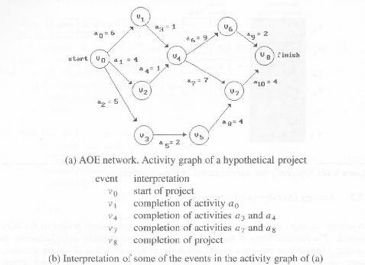
*Figure 6.41:An AOE network(p.310)
concurrent
CHAPTER 6

Slide 91
Application of AOE Network
Evaluate performance
  minimum amount of time
  activity whose duration time should be shortened
  …
Critical path
  a path that has the longest length
  minimum time required to complete the project
  v0, v1, v4, v7, v8 or v0, v1, v4, v6, v8 (18)
CHAPTER 6

Slide 92
other factors
Earliest time that vi can occur
  the length of the longest path from v0 to vi
  the earliest start time for all activities leaving vi
  early(6) = early(7) = 7
Latest time of activity
  the latest time the activity may start without increasing the project duration
  late(5)=8, late(7)=7
Critical activity
  an activity for which early(i)=late(i)
  early(7)=late(7)
late(i)-early(i)
  measure of how critical an activity is
  late(5)-early(5)=8-5=3
CHAPTER 6

Slide 93
earliest, early, latest, late
16
6
v1
v6
16
6
0
a3=1
7
a9=2
a0=6
16
0
6
7
a6=9
18
0
6
10
v4
7
v8
v0
0
14
a1=4
4
7
7
0
14
18
4
a4=1
a7=7
2
a10=4
v2
6
v7
14
0
6
14
a2=5
7
3
a8=4
7
5
14
v3
5
v5
a5=2
8
10
8
CHAPTER 6

Slide 94
Determine Critical Paths
Delete all noncritical activities
Generate all the paths from the start to finish vertex.
CHAPTER 6

Slide 95
Calculation of Earliest Times
earliest[j]
  the earliest event occurrence time
latest[j]
  the latest event occurrence time
earliest[0]=0
earliest[j]=max{earliest[i]+duration of <i,j>}
i ∈p(j)
v_{k}
a_{i}
v_{l}
early(i)=earliest(k)
late(i)=latest(l)-duration of a_{i}
CHAPTER 6

Slide 96
v_{i1}
v_{i2}
forward stage
v_{j}
.
.
.
v_{in}
if (earliest[k] < earliest[j]+ptr->duration)
earliest[k]=earliest[j]+ptr->duration
CHAPTER 6

Slide 97
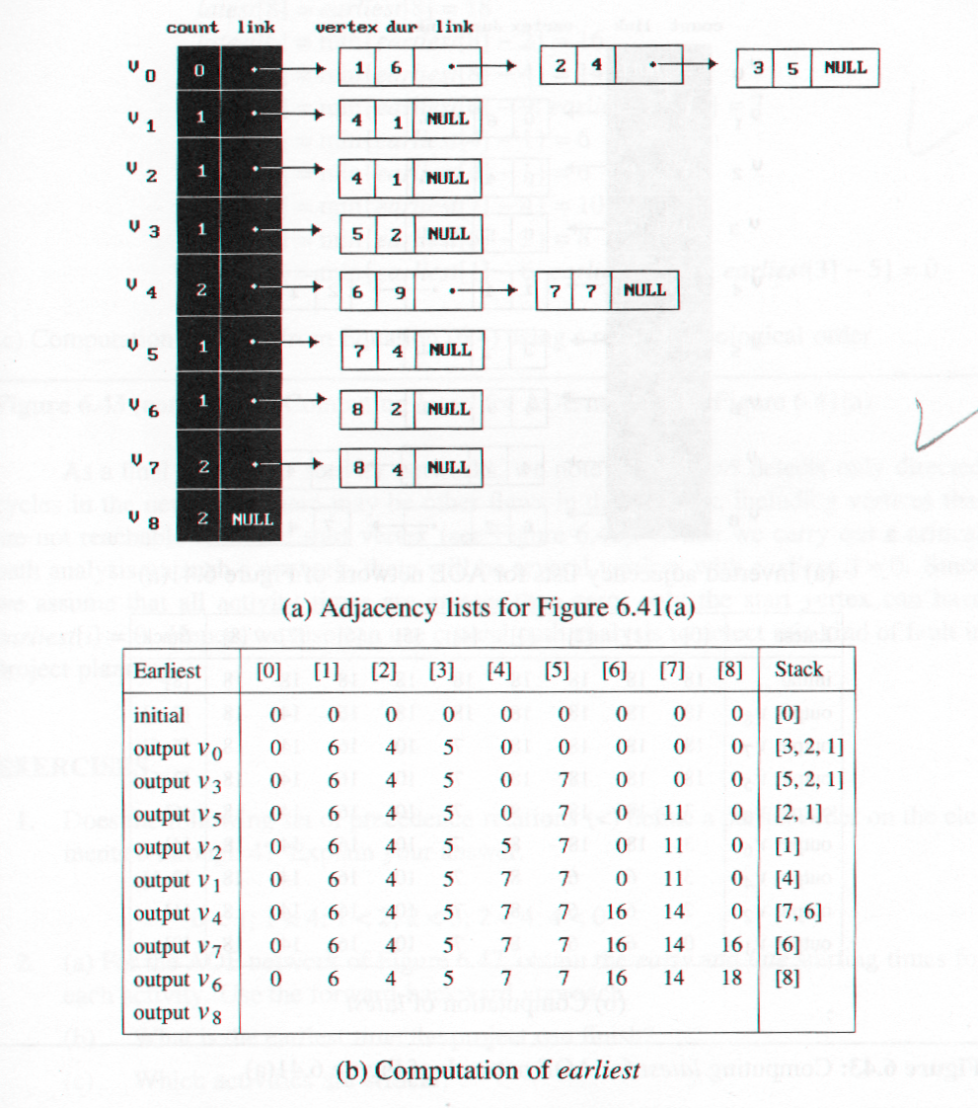
*Figure 6.42:Computing earliest from topological sort (p.313)
v1
v6
v0
v4
v8
v2
v7
v3
v5
CHAPTER 6

Slide 98
Calculation of Latest Times
latest[j]
  the latest event occurrence time
latest[n-1]=earliest[n-1]
latest[j]=min{latest[i]-duration of <j,i>}
i ∈s(j)
v_{i1}
v_{j}
v_{i2}
backward stage
.
.
.
v_{in}
if (latest[k] > latest[j]-ptr->duration)
latest[k]=latest[j]-ptr->duration
CHAPTER 6

Slide 99
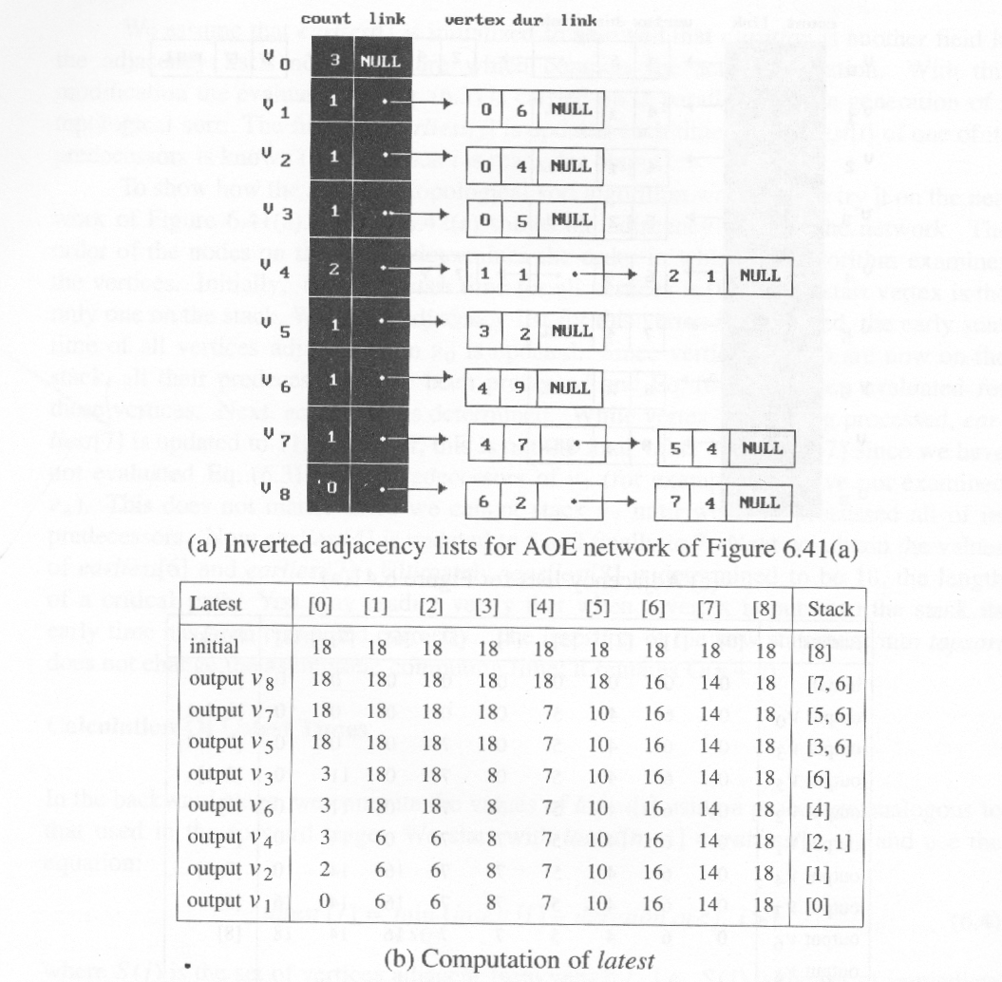
*Figure 6.43: Computing latest for AOE network of Figure 6.41(a)(p.314)
CHAPTER 6

Slide 100
*Figure 6.43(continued):Computing latest of AOE network of Figure 6.41(a)
(p.315)
latest[8]=earliest[8]=18
latest[6]=min{earliest[8] - 2}=16
latest[7]=min{earliest[8] - 4}=14
latest[4]=min{earliest[6] - 9;earliest[7] -7}= 7
latest[1]=min{earliest[4] - 1}=6
latest[2]=min{earliest[4] - 1}=6
latest[5]=min{earliest[7] - 4}=10
latest[3]=min{earliest[5] - 2}=8
latest[0]=min{earliest[1] - 6;earliest[2]- 4; earliest[3] -5}=0
(c)Computation of latest from Equation (6.4) using a reverse topological order
CHAPTER 6

Slide 101
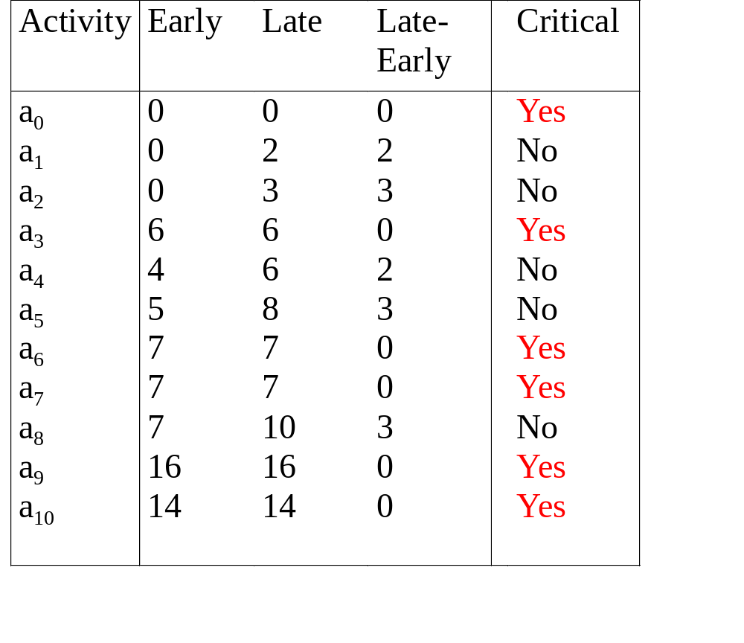
*Figure 6.44:Early, late and critical values(p.316)
CHAPTER 6

Slide 102
*Figure 6.45:Graph with noncritical activities deleted (p.316)
V₁
V₆
a₃
a₆
a₉
a₀
V₀
V₄
V₈
a₇
a₁₀
V₇
CHAPTER 6

Slide 103
*Figure 6.46: AOE network with unreachable activities (p.317)
a₄
V₃
V₄
V₁
a₅
a₆
earliest[i]=0
a₀
a₂
V₀
V₅
a₁
a₃
V₂
CHAPTER 6

Slide 104
*Figure 6.47: an AOE network(p.317)
a₂=3
a₆=4
V₁
V₃
V₆
a₁₂=4
a₀=5
a₇=4
a₃=6
a₁₀=5
a₁₃=2
V₀
a₅=3
V₅
V₈
V₉
finish
start
a₈=1
a₁₁=2
a₁=6
V₂
V₄
V₇
a₄=3
a₉=4
CHAPTER 6

